Slide 1
Co-Simulating Caldera and its control strategies with Open-DSS Don Scoffield Manoj Kumar Cebol Sundarrajan

Slide 2
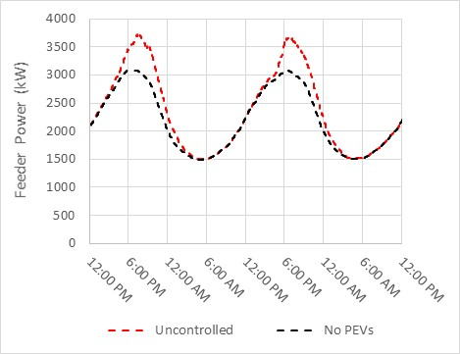
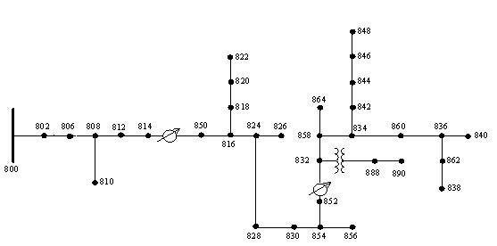
Composition and Purpose of Development and Testing Platform
This Caldera & OpenDSS co-simulation platform has been set up to be able to develop, test, and debug PEV charging control strategies.
OpenDSS is running the IEEE-34 node feeder
The non-pev feeder load is a scaled version of a typical PG&E residential load profile.
Peak feeder load: 3000 kW no pev charging, 3600 with uncontrolled pev charging
The load profile can be found in the file ‘./Input/baseLD_*.csv’
This load profile is ‘played’ into the non-pev loads in the OpenDSS simulation. It is also used by control strategies that requires a feeder load forecast for non-pev loads.
200 PEVs are charged each day
PEV Charging needs for this simple example info was derived from EV Project Data for the PG&E service territory.
Arrival Time, Departure Time, Initial SOC, …
Notes:
Michael’s Questions:
How do we help answer the questions of utility managers asking ‘what do I need to do?’
How does smart charging provide value?
I think he was asking this in the regard that EV drivers will get a ‘check’ for providing services. We probably need to work to frame this appropriately
How do we implement smart charging technology?
What is the net good or bad that EVs produce?

Slide 3
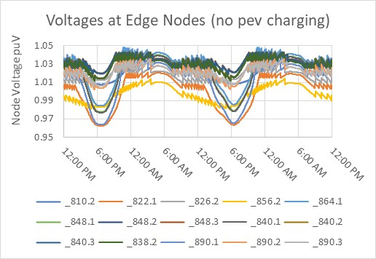
Composition and Purpose of Development and Testing Platform
When there is no PEV charging all voltages at the edge nodes or leaf nodes are between 0.95 and 1.05 pu.
In this simple example, nodes 856.2, 826.2, 810.2, 838.2 each consists of 50 Supply equipments.
This is defined in the ‘SE_*.csv’ input file and pev charging locations should be moved to various points on the feeder when testing and debugging control strategies to support voltage.
Notes:
Michael’s Questions:
How do we help answer the questions of utility managers asking ‘what do I need to do?’
How does smart charging provide value?
I think he was asking this in the regard that EV drivers will get a ‘check’ for providing services. We probably need to work to frame this appropriately
How do we implement smart charging technology?
What is the net good or bad that EVs produce?

Slide 4
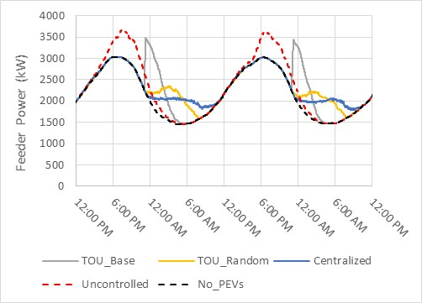
Demonstration of Recharge Control Strategies
Uncontrolled
In the ‘CE_*.csv’ file add ‘NA’ to the records in the column named ES_strategy
TOU Rates (Baseline)
In the ‘CE_*.csv’ file add ‘ES100-A’ to the records in the column named ES_strategy
Random Start – Dwell/TOU
In the ‘CE_*.csv’ file add ‘ES100-B’ to the records in the column named ES_strategy
Centralized Energy Shifting – Reduce Feeder Peak
In the ‘CE_*.csv’ file add ‘ES500’ to the records in the column named ES_strategy
*In the example simulations the off-peak rate window is from 11 pm to 8 am.
Notes:
Michael’s Questions:
How do we help answer the questions of utility managers asking ‘what do I need to do?’
How does smart charging provide value?
I think he was asking this in the regard that EV drivers will get a ‘check’ for providing services. We probably need to work to frame this appropriately
How do we implement smart charging technology?
What is the net good or bad that EVs produce?

Slide 5
Setting up the Simulation Environment and Running the Example
It is highly recommended to use Anaconda to manage software dependencies.
Steps to set up Anaconda Environment
Install Anaconda
Create new anaconda environment and install required software
Run following commands from Linux terminal or anaconda prompt in Windows 10
conda create --name Caldera python=3.7
conda activate Caldera
conda install -c anaconda pandas numpy
conda install -c anaconda cvxopt protobuf
conda install -c anaconda scipy
pip install 'OpenDSSDirect.py[extras]’
conda install -c gmlc-tdc helics
pip install helics_apps==2.5.0
Running example
Open Linux terminal or anaconda prompt in windows and run following commands:
conda activate Caldera
python start_execution.py
Notes:
Michael’s Questions:
How do we help answer the questions of utility managers asking ‘what do I need to do?’
How does smart charging provide value?
I think he was asking this in the regard that EV drivers will get a ‘check’ for providing services. We probably need to work to frame this appropriately
How do we implement smart charging technology?
What is the net good or bad that EVs produce?

Slide 6
Important Note
It is important to make sure that all Caldera output files located in the ‘./Output’ directory are either deleted or closed prior to starting a Caldera simulation.
The behavior of what happens when these files are open when a Caldera simulation is started depends on the operating system.
On a windows 10 system the following error is thrown:
This is an area for future improvement. But in the meantime if you see this error, simply close or delete the Caldera output file.
Notes:
Michael’s Questions:
How do we help answer the questions of utility managers asking ‘what do I need to do?’
How does smart charging provide value?
I think he was asking this in the regard that EV drivers will get a ‘check’ for providing services. We probably need to work to frame this appropriately
How do we implement smart charging technology?
What is the net good or bad that EVs produce?

Slide 7
PEV charging load models in Open-DSS
OpenDSS load objects for all pev loads are defined in the file named ‘./OpenDSS/SE_Loads.dss’
The following naming convention is used for these loads
For single phase Level 1 or Level 2 loads
pev1p_(OpenDSS node name)
pev1p_806.1 -> All Level 1 and Level 2 PEV charging on node 806.1 is aggregated and sent to this 1 phase openDSS load.
For three phase DCFC or XFC loads
pev3p_(OpenDSS bus name)
pev3p_806 -> All DCFC or XFC charging on bus 806 is aggregated and sent to this this 3 phase openDSS load.
All node_id values specified in the supply equipment file ‘SE_*.csv’ are checked to ensure:
A node with that name exists inside open dss.
There exists a corresponding load object with the name consistent with the naming convention described above.
Notes:
Michael’s Questions:
How do we help answer the questions of utility managers asking ‘what do I need to do?’
How does smart charging provide value?
I think he was asking this in the regard that EV drivers will get a ‘check’ for providing services. We probably need to work to frame this appropriately
How do we implement smart charging technology?
What is the net good or bad that EVs produce?

Slide 8
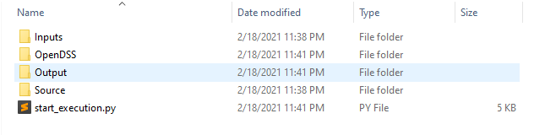
Files and Directory Structure
There are four directories
Source -> Contains the compiled Caldera modules and helics Federates along with modifiable source code for load_inputs, control_strategies and opendss.
OpenDSS -> Contains .dss files which describes the feeder description to be loaded into OpenDSS.
Inputs -> Contains the input files read by Caldera.
Output -> Contains output files created in this example.
There is one python file
start_execution.py
Sets up timing constraints (start, end, timestep)
Starts the Caldera and Open-DSS and external control strategy federates
Notes:
Michael’s Questions:
How do we help answer the questions of utility managers asking ‘what do I need to do?’
How does smart charging provide value?
I think he was asking this in the regard that EV drivers will get a ‘check’ for providing services. We probably need to work to frame this appropriately
How do we implement smart charging technology?
What is the net good or bad that EVs produce?

Slide 9
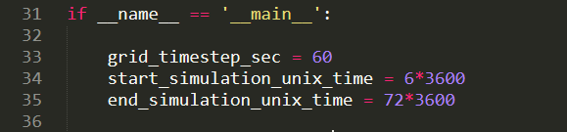
Important variables in start_execution.py
There are few important variables defined in start_execution.py
grid_timestep_sec
Defines simulation time step size between Caldera and OpenDSS in seconds.
start_simulation_unix_time
Defines start of simulation in seconds or unix time
end_simulation_unix_time
Defines end of simulation in seconds or unix time
Notes:
Michael’s Questions:
How do we help answer the questions of utility managers asking ‘what do I need to do?’
How does smart charging provide value?
I think he was asking this in the regard that EV drivers will get a ‘check’ for providing services. We probably need to work to frame this appropriately
How do we implement smart charging technology?
What is the net good or bad that EVs produce?

Slide 10
Important variables in the openDSS_aux.py
Important variables under opendss class
dss_file_name – filename of .dss file under OpenDSS directory
The high level opendss functionality is divided in 4 classes.
open_dss_core
core power solving functionality is defined here
open_dss_Caldera
defines interaction with Caldera and opendss
open_dss_external_control
interaction with opendss and external control is defined under here.
open_dss_logger
logging functionality is defined here.
important variables
node_voltages_to_log
node_pev_charging_to_log
Notes:
Michael’s Questions:
How do we help answer the questions of utility managers asking ‘what do I need to do?’
How does smart charging provide value?
I think he was asking this in the regard that EV drivers will get a ‘check’ for providing services. We probably need to work to frame this appropriately
How do we implement smart charging technology?
What is the net good or bad that EVs produce?

Slide 11
Global Input File
feeder_power_limit_kW
Max feeder power in kW. This value is used by some control strategies.
base_load_forecast_adjust_interval_hrs
Used when interpolating between the actual and forecasted feeder loads in the ‘baseLD_*.csv’ file.
Notes:
Michael’s Questions:
How do we help answer the questions of utility managers asking ‘what do I need to do?’
How does smart charging provide value?
I think he was asking this in the regard that EV drivers will get a ‘check’ for providing services. We probably need to work to frame this appropriately
How do we implement smart charging technology?
What is the net good or bad that EVs produce?

Slide 12
OpenDSS Base Load Input File
data_start_time_unix_time
The unix time of the beginning of the load data.
If data_start_time_unix_time < start_simulation_unix_time then Caldera throws an error.
Beginning of the load data must proceed the beginning of the simulation
time_step_sec
The time step in seconds corresponding to the load data.
actual_non_pev_net_load_akW
The aggregate load profile of all loads on the feeder except electric vehicles.
forecasted_non_pev_net_load_akW
The forecasted aggregate load profile of all loads on the feeder except electric vehicles.
Notes:
Michael’s Questions:
How do we help answer the questions of utility managers asking ‘what do I need to do?’
How does smart charging provide value?
I think he was asking this in the regard that EV drivers will get a ‘check’ for providing services. We probably need to work to frame this appropriately
How do we implement smart charging technology?
What is the net good or bad that EVs produce?

Slide 13
Available Caldera Control strategies
ES100
Time of use rate control strategies.
There are three different modes for this control strategy (M1, M2, M3)
ES110
Selects charge time randomly during the park.
Charging at any time during the park is equally likely.
ES500
Centralized Energy Shifting
Initially developed in the GM0085 project
Optimizes PEV charging via centralized aggregator / optimization solver
VS200
Voltage Support using reactive power
Uses volt-var curve

Slide 14
ES100 Parameters File
Located in ‘./Input/parameters/’
There are two identical input files ‘ES100-A.csv’ and ‘ES-100-B.csv’
Allows 2 ‘time of use rate’ control strategies to be used in the same simulation.
beginning_of_TofU_rate_period__time_from_midnight_hrs
Defines the beginning of the time of use rate window.
-1 -> 11 pm, 0 -> 12 am, 3.25 -> 3:15 am, …
end_of_TofU_rate_period__time_from_midnight_hrs
Defines the end of the time of use rate window.
6 -> 6 am, 7 -> 7 am, 8.5 -> 8:30 am, …
randomization_method (M1, M2, M3)
M1 -> Randomize charge start times between start of time of use window and start of time of use window + M1_delay_period_hrs.
M2 -> PEV charging that overlaps with the time of use rate window is randomized during the time of use rate window.
M3 - PEV charging that overlaps with the time of use rate window is randomized during the time of use rate window. Other PEV charging is randomized during the park window.
M1_delay_period_hrs
Used only in M1 strategy.
Defines the random window used to select PEV charge start times.

Slide 15
ES110 Parameters File
Located Under ‘Input/parameters/ES110.csv’
random_seed
Used to generate random charge start time.
Useful for replicating results.

Slide 16
ES500 Parameters File
There are many parameters in this file the most important are described below:
aggregator_timestep_mins
Size of the time step in minutes that the aggregator uses when optimizing PEV charging.
charging_needs_lead_time_sec
Time in seconds prior to the beginning of the next aggregator time step when the aggregator requests PEV charging needs.
energy_setpoints_lead_time_sec
Minimum time in seconds prior to the beginning of the next aggregator time step when each PEV expects to have the energy setpoint from the aggregator.
prediction_horizon_duration_hrs
The forward looking time period over which the optimization decision is made.

Slide 17
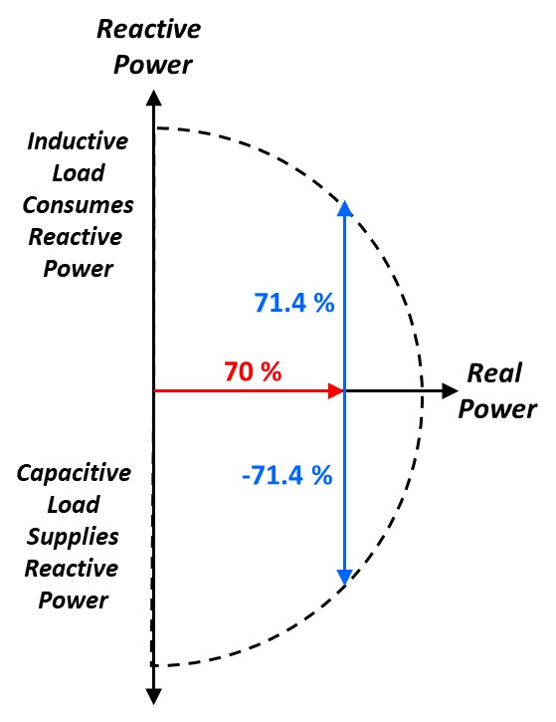
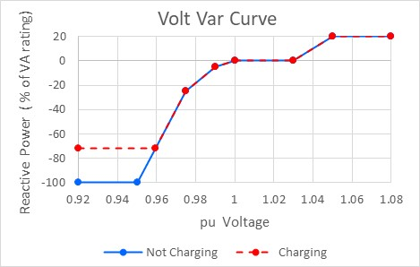
VS200 Voltage support using Reactive Power
The volt var curve maps pu voltage to a reactive power setpoint
In Caldera the volt var curve can contain any number of points that defines a non-decreasing curve.
Sign convention of volt var curve views PEV as load not generator
Negative reactive power -> Capacitive load that supplies Q
Positive reactive power -> Inductive load that consumes Q
PEVs able to provide reactive power support if:
PEV is plugged in
PEV is not charging at max charge rate
A PEV charging setpoint is used to ensure PEVs can provide reactive power support when charging
In this scenario
Capacity of each PEV charger is 6.6 kVA
PEV charging setpoint is 70% of capacity (4.62 kW)
When charging, each PEV can provide reactive power from -71.4% to 71.4% of capacity (-4.71 to 4.71 kVAR)
When not charging each PEV can provide reactive power from -6.6 kVAR to 6.6 kVAR

Slide 18
VS200 Parameters File
target_P3_reference__percent_of_maxP3
The PEV charging setpoint used to ensure PEVs can provide reactive power support when charging.
max_delta_kVAR_per_min
Maximum allowed ramping in Q between successive time steps (kVAR / min)
volt_var_curve
Volt-var curve (Non-decreasing curve that can contain any number of points).
can_provide_reactive_power_after_battery_full
True -> PEV is able to provide reactive power support even after the PEV finishes charging.
False -> PEV is able to provide reactive power only when PEV battery is not full.
voltage_LPF
A low pass filter used to filter the node voltages before being used by the VS200 control strategy.

Slide 19
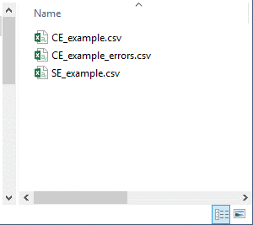
Caldera Input File Validation
The Caldera Input Files are checked for invalid data prior to starting the co-simulation.
If invalid data is found in input files, then files containing descriptive error messages are created and the co-simulation is terminated.
Errors will be logged in a file saved in the Input directory. The file name is created as follows:
(input file name)_errors.csv
Example
Input file name: CE_Scenario_2_EPRI_Med_2030_ChargeEventTable.csv
Error file name: CE_Scenario_2_EPRI_Med_2030_ChargeEventTable_errors.csv
An error message is also printed to the command window.
Caldera: Not Initialized Check Log Files.
Notes:
Michael’s Questions:
How do we help answer the questions of utility managers asking ‘what do I need to do?’
How does smart charging provide value?
I think he was asking this in the regard that EV drivers will get a ‘check’ for providing services. We probably need to work to frame this appropriately
How do we implement smart charging technology?
What is the net good or bad that EVs produce?

Slide 20
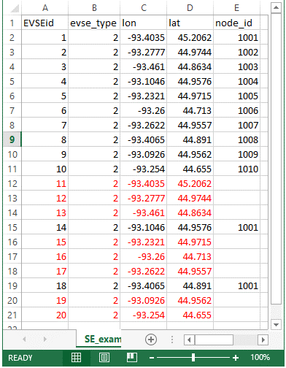
Mapping Supply Equipment to Open-DSS node ids
The Caldera input contains the Supply Equipment and Charge Events for the entire metro areas.
Open-DSS only needs the Supply Equipment (and associated Charge Events) that is located on the feeder that is being simulated.
The mapping of Supply Equipment to Open-DSS node ids is done in the Supply Equipment File.
The fifth column (named ‘node_id’) facilitates this mapping.
If the node_id cell is blank then the corresponding Supply Equipment (and associated Charge Events) will not be loaded into Caldera.
The node id can be any valid asci string.
The node id must be valid Open-DSS nodes.
All supply equipment that is not located on the feeder being simulated should be assigned an empty string as the node id.
SE_group is an integer and can be used to group supply_equipments to provide targeted group control.
Notes:
Michael’s Questions:
How do we help answer the questions of utility managers asking ‘what do I need to do?’
How does smart charging provide value?
I think he was asking this in the regard that EV drivers will get a ‘check’ for providing services. We probably need to work to frame this appropriately
How do we implement smart charging technology?
What is the net good or bad that EVs produce?

Slide 21
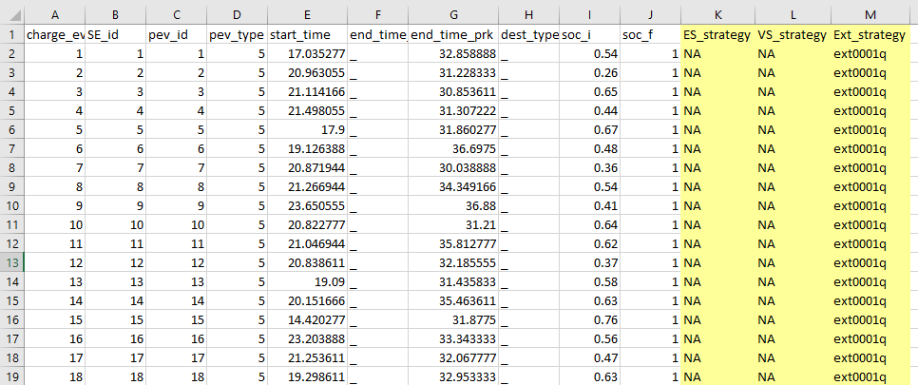
Mapping Control Strategies to Charge Events
Charge Events file ‘CE_*.csv’ describes the charge events in Caldera.
The last three columns describes the Energy Shifting (ES), Voltage Support (VS) and External Control strategies that are associated with each charge event.
If there is no control strategy associated with the Charge events, NA is used.
Currently, ES control strategies implemented in Caldera are ES100-A, ES100-B, ES110, ES500.
Ext_strategy cannot be used with ES_strategy and VS_strategy, But ES_strategy and VS_strategy can be used together.
Notes:
Michael’s Questions:
How do we help answer the questions of utility managers asking ‘what do I need to do?’
How does smart charging provide value?
I think he was asking this in the regard that EV drivers will get a ‘check’ for providing services. We probably need to work to frame this appropriately
How do we implement smart charging technology?
What is the net good or bad that EVs produce?

Slide 22
Ext_strategy identifier
The last column in CE_*.csv file specifies the Ext_strategy used.
The format is extxxxx(q)
ext – fixed
xxxx – Any 4 digit integer identifying the strategy
q – optional, provides ability to control reactive power by the control strategy if specified.
Notes:
Michael’s Questions:
How do we help answer the questions of utility managers asking ‘what do I need to do?’
How does smart charging provide value?
I think he was asking this in the regard that EV drivers will get a ‘check’ for providing services. We probably need to work to frame this appropriately
How do we implement smart charging technology?
What is the net good or bad that EVs produce?

Slide 23
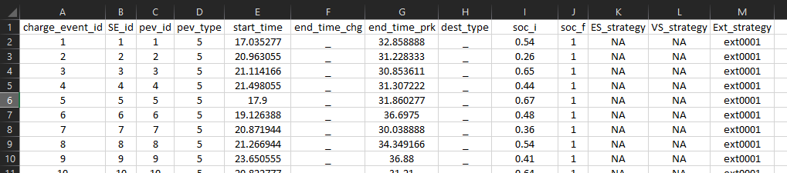
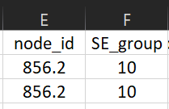
Volt/Watt control
The last column in CE_*.csv file should be changed to ext0001 for Volt/Watt control.
Fill SE_group and node_id columns in SE_.csv. SE_group is the zone identifier.
Notes:
Michael’s Questions:
How do we help answer the questions of utility managers asking ‘what do I need to do?’
How does smart charging provide value?
I think he was asking this in the regard that EV drivers will get a ‘check’ for providing services. We probably need to work to frame this appropriately
How do we implement smart charging technology?
What is the net good or bad that EVs produce?

